Slide 1
Reusing 60GHz Radios for Mobile Radar Imaging
Yanzi Zhu, Yibo Zhu,
Ben Y. Zhao and Heather Zheng
U.C. Santa Barbara
yanzi@cs.ucsb.edu

Slide 2

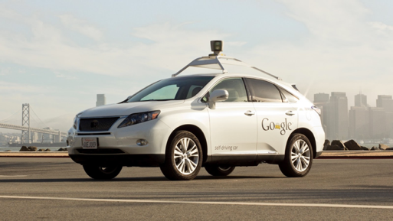
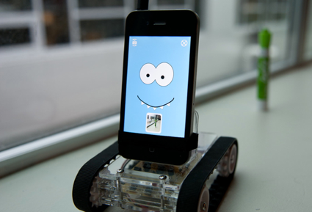
Today and the Future
Today things are controlled by human
Drones, cars, smartphones, etc.
The future: unmanned autonomous agents
Drone
Delivery/Pickup
Self-driving
Car
Smartphone
Robot

Slide 3
Today and the Future
Today things are controlled by human
Drones, cars, smartphones, etc.
The future: unmanned autonomous agents
Need Mobile Imaging
Drone
Delivery/Pickup
Self-driving
Car
Smartphone Robot

Slide 4

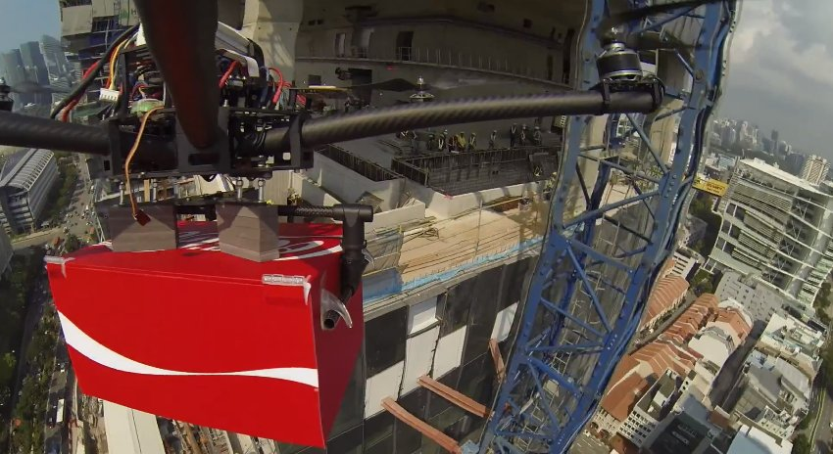
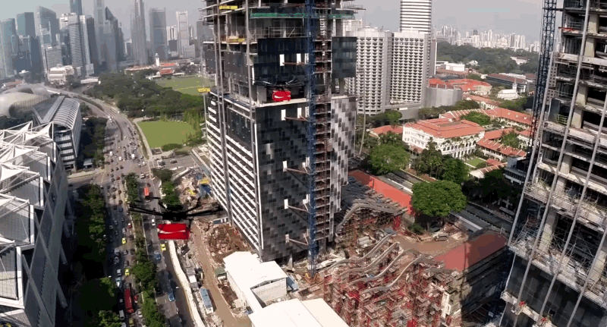
Beyond Localization
Not only “where” (object location), but also “what” (shape and material)

Slide 5
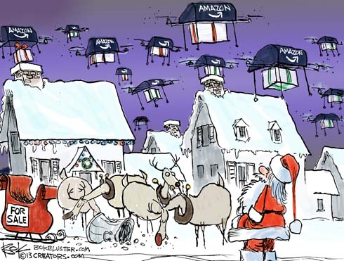
Requirements
cm-level accuracy
Mobile (drones ~40cm) and objects (~20cm) are small
Google self-driving car requires ~3cm
Robust: work in various conditions
Darkness, rain…
Portable & affordable
Drones at night

Slide 6
Existing Solutions Not Suitable
Vision- and sound-based
Not working in darkness, or with background noise
Cannot tell object material
Traditional radar
Bulky (>1m, >10kg) and expensive
Modern radar (e.g., mmWave)
Require specialized hardware

Slide 7
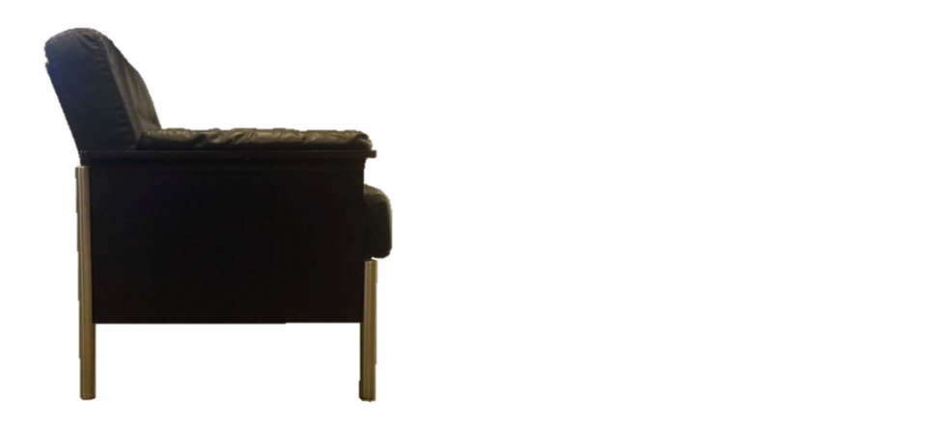
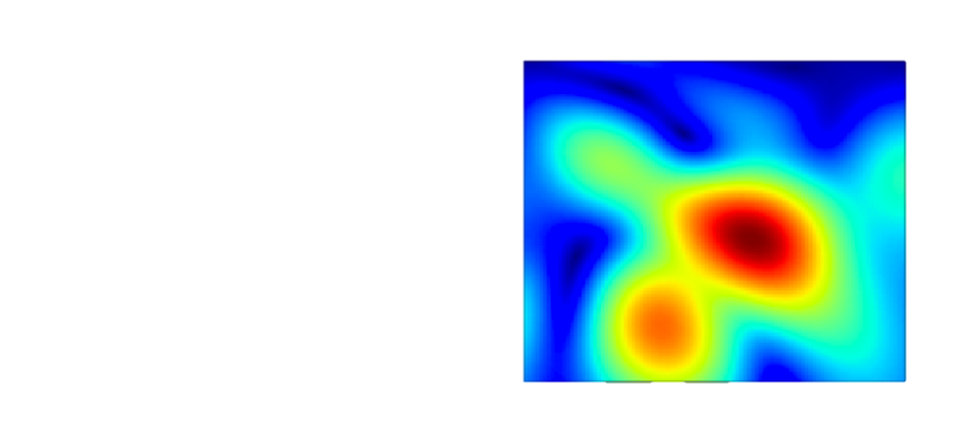
WiFi Imaging
Fundamentally limited by resolution
radar resolution = wavelength × distance / antenna array size
distance = 3m
smartphone-sized array
(10cm)
resolution = 1.8m

Slide 8
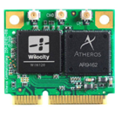
Leveraging 60GHz Radios
Tri-band Wi-Fi solutions from Qualcomm Atheros
integrate … 60 GHz spectrum band along
with … 5 GHz band and … 2.4 GHz band.
-- Qualcomm Press Release
Robust, portable, and affordable (<$37.5)
Work in darkness and rain^{[1]}
Stable and predictable propagation
High directionality & minimal multi-path effects
Resolution is 12× better than WiFi 5GHz
resolution = wavelength × distance / array size
[1] Demystifying 60GHz Outdoor Picocells. MobiCom, 2014

Slide 9


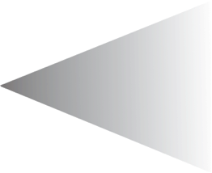



Synthetic Aperture Radar
Key idea of SAR:
Emulate a large antenna array using a small antenna
∝
TX
TX
1m
1m
Real array combines measurements from different elements
Synthetic array moves the antenna to receive signal at different locations

Slide 10
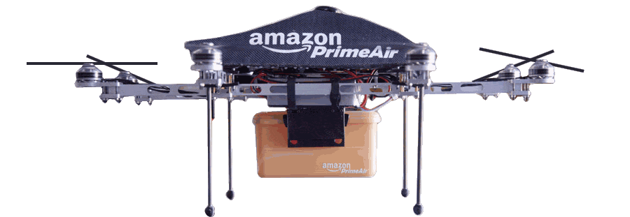
SAR Insufficient
Problem: movement noise > wavelength (5mm)
mm-level localization impossible
Noise causes phase error → poor imaging results
E.g., noise-free vs. 5mm random noise
Ideal
Actual
32cm error!

Slide 11


SAR
Our Approach
surface = many points
surface = single unit
Object
Object
Location, Material,
Curvature, Width
↑
TX
Imaging Result
Measurements
→
RSS Profiles
RSS + Phase
RSS + AoA (60GHz)
Sensitive to movement noise
Robust to movement noise

Slide 12
SAR
Our Approach
surface = many points
surface = single unit
Object
Object
RSS Series Analysis
Location, Material,
Curvature, Width
↑
Imaging Result
Measurements
→
RSS Profiles
RSS + Phase
RSS + AoA (60GHz)
Sensitive to movement noise
Robust to movement noise

Slide 13




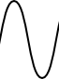
System Overview
1
Object
2
3
TX
Measurements
Beam on direction 2
RX
Move 1m along this direction
RSS Profiles
Sensing objects and movement planning
RSS Series Analysis
location→ curvature → width→ material

Slide 14
Determine Curvature
Principle: surface reflects signals like a mirror
(60GHz) AoAs of strongest RSS → TX mirror point
TX mirror point → curvature and radius
Mirror of TX
Mirror of TX
Object Location
TX
TX
Physics + Geometry

Slide 15
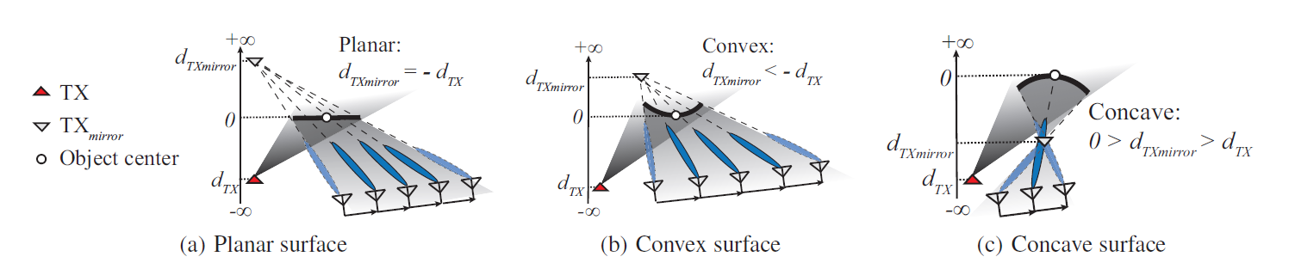

$$\frac{1}{f}=\frac{1}{d_{TX}}+\frac{1}{d_{TXmirror}}$$

Slide 16
Determine Width
Principle: RSS shape varies with surface width
Modeling 60GHz reflection → predict RSS profiles
1
30cm
flat
1
10cm
flat
Norm. RSS
Norm. RSS
0
0
Measurement Index
Measurement Index
30cm
⋮
10cm
Best match!
Predict
Predict
1
1
Norm. RSS
Norm. RSS
Estimated width = 10cm
0
0

Slide 17
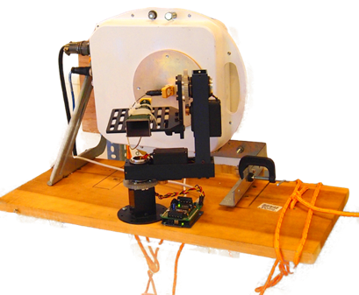
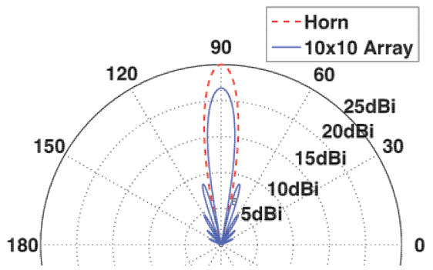
Testbed
Ideal: steerable phased array (unavailable)
Our testbed: HXI radios + horn antenna
Fine-grained mechanical rotator (unit of 0.15°)
Phased array main beam similar to horn
EIRP is 17dB weaker than commodity radios^{[1]}
[1] Wilocity’s 60GHz chipset from Qualcomm (whitepaper)

Slide 18
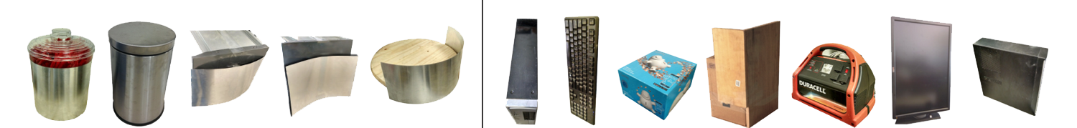
Experiments with Real Objects
Curved
Flat
TX-object distance = 2m & RX-object distance = 3.5m
Inject <10cm trajectory deviation and positioning error
Centimeter accuracy
Localization error < 10cm
Width error < 4.5cm
Narrow down to 3 materials among 39 choices in database

Slide 19

Only The First Step
Leverage 60GHz radios to image the objects in presence of movement noise
First step towards 3D mapping
2D is feasible when devices move to cover an area
Limitations
Focus on static objects
TX and RX need line-of-sight to the objects
Lack fine-grained details

Slide 20
Thanks! Questions?

